Slide 1
APNADUKAN
Section: K19JC
Course Code: INT213
Degree: B.tech CSE

Slide 2
DEVLOPERS
Name | Reg. No | Roll No.
ADARSA SWAIN | 11908633 | 27

Slide 3
Contents
Topic | Pg. No.
Acknowledgement | 4
Abstract | 5
Introduction | 6
CODE | 7
Screenshots | 10
Conclusion | 14
Bibilogy | 15

Slide 4
Acknowledgement
We would like to express our special thanks of gratitude to our teacher Mr.Sagar Pande who gave us the golden opportunity to do this wonderful project on the topic ‘APNADUKAN ’, which also helped us in doing a lot of research and we came to know about so many new things, we are really thankful.

Slide 5
Abstract
This project was developed with at most care and concern by Myself for python programming using Django along with css, javascript, html.
The Apnadukan is a eccomerce website Where we you get your product and track your product , and give your feedback policies.
Now all you have to go to the homepage and buy your product in the best prices.

Slide 6
Introduction
Our goal in this project to provide our user a model to buy their own
Django is a Python-based free and open-source web framework that follows the model-templates-views architectural pattern.
It also has the css, javascript, html for frontened developing.

Slide 7
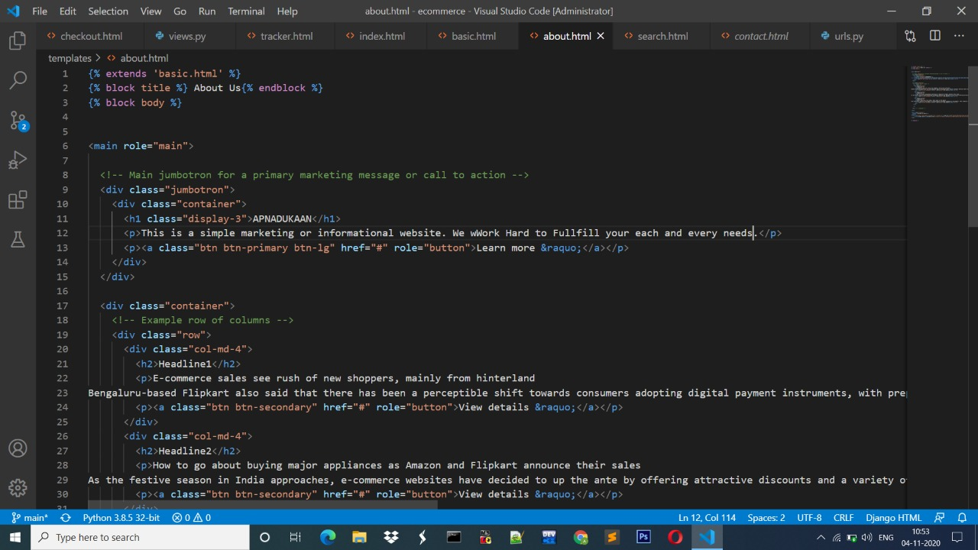


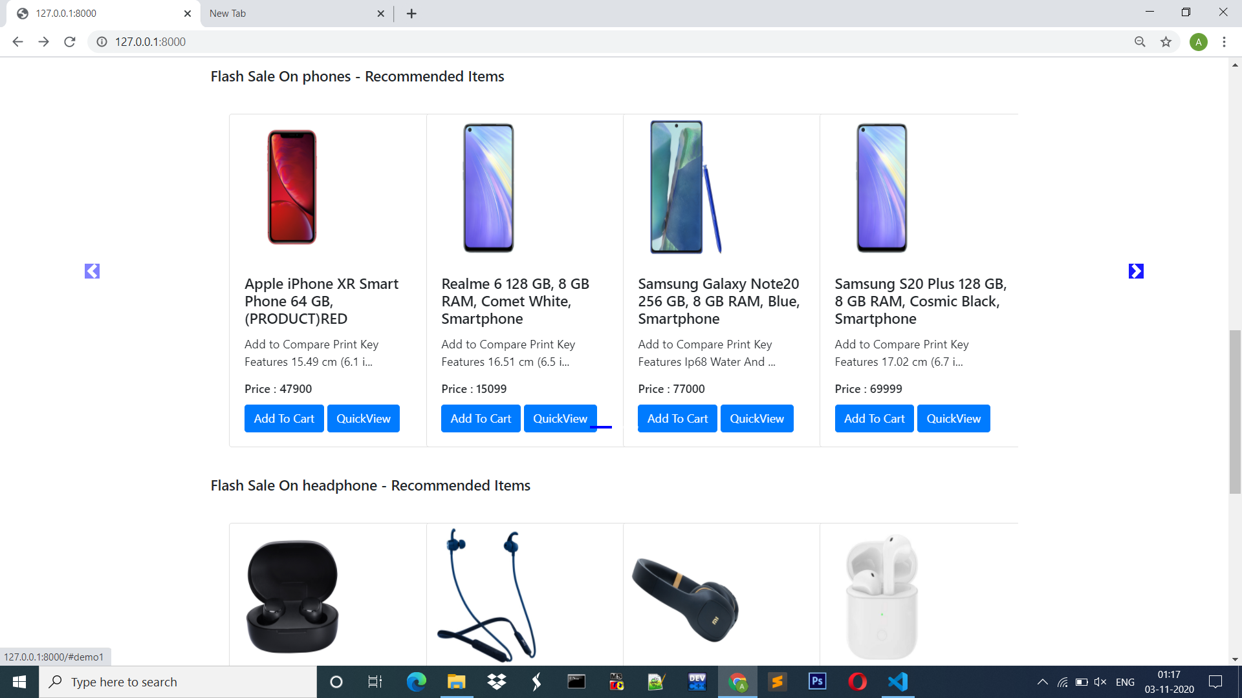
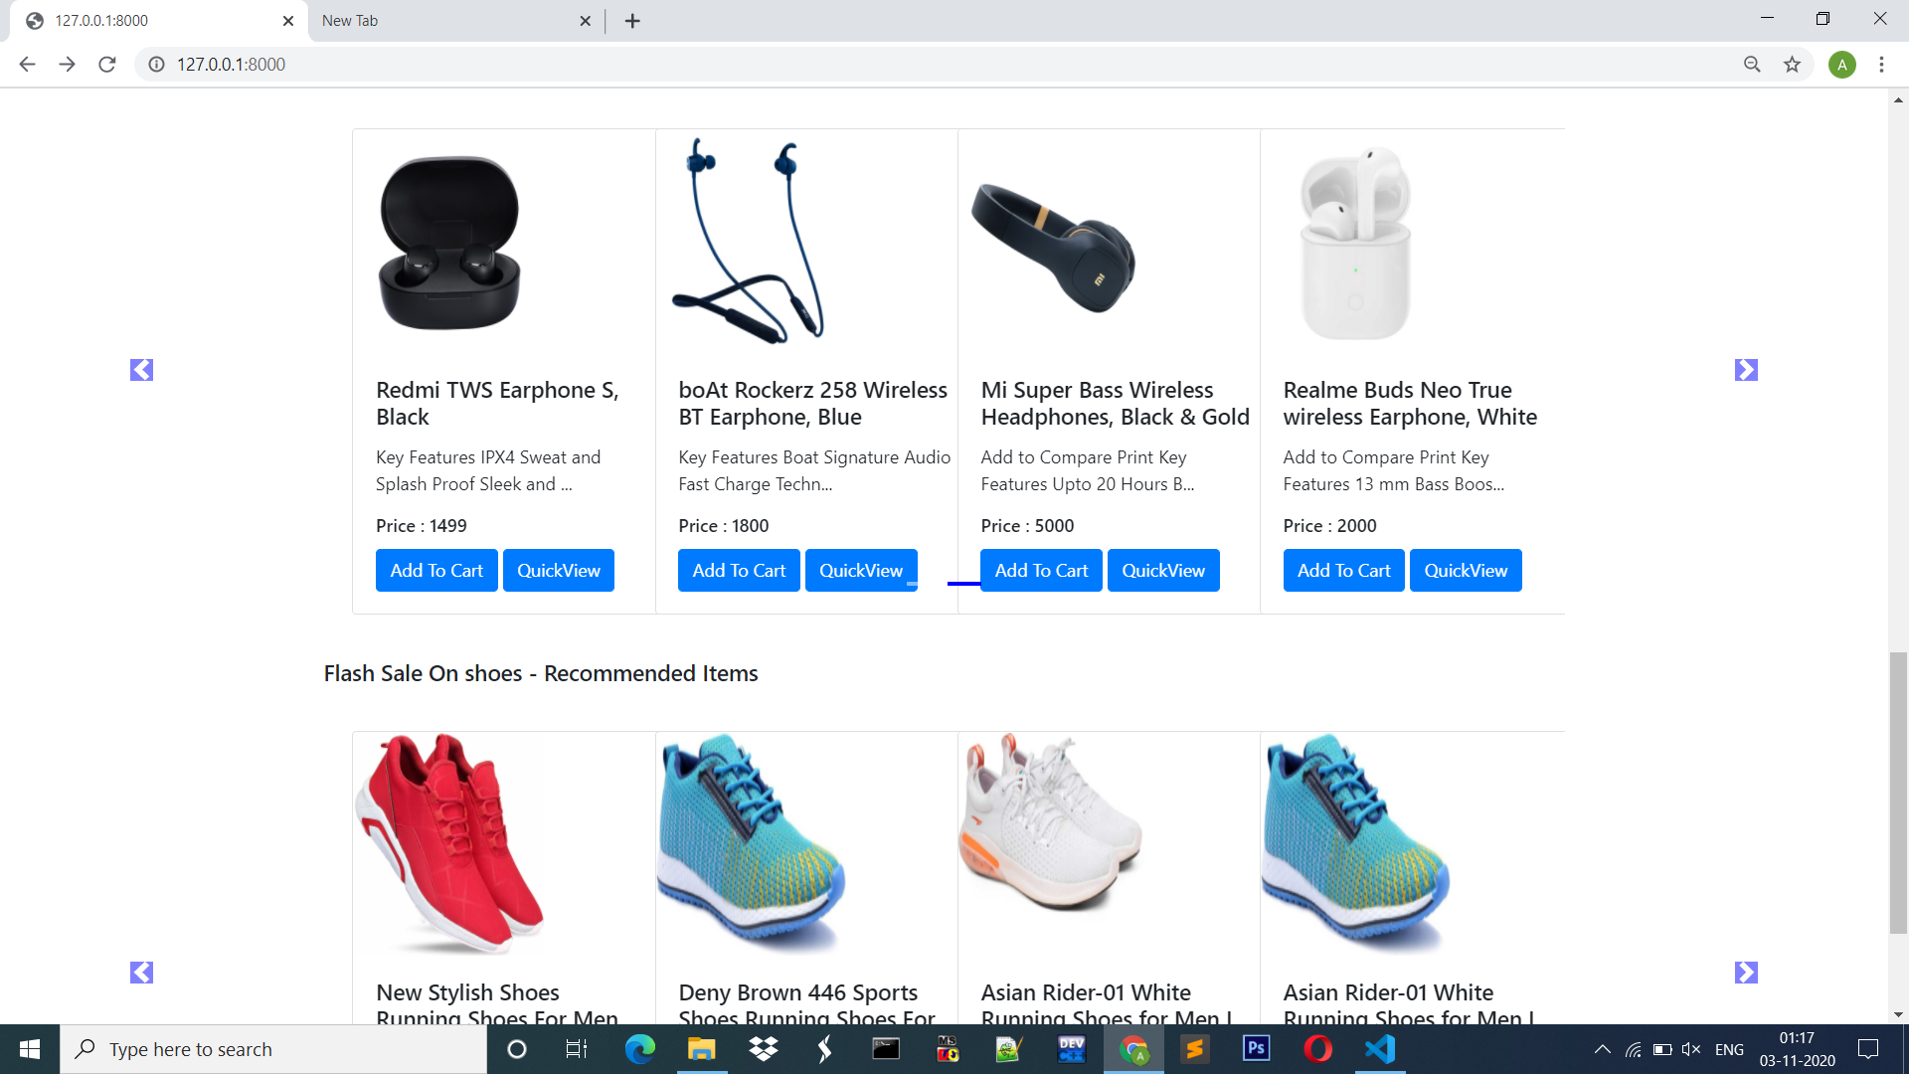
Screen Shots

Slide 8
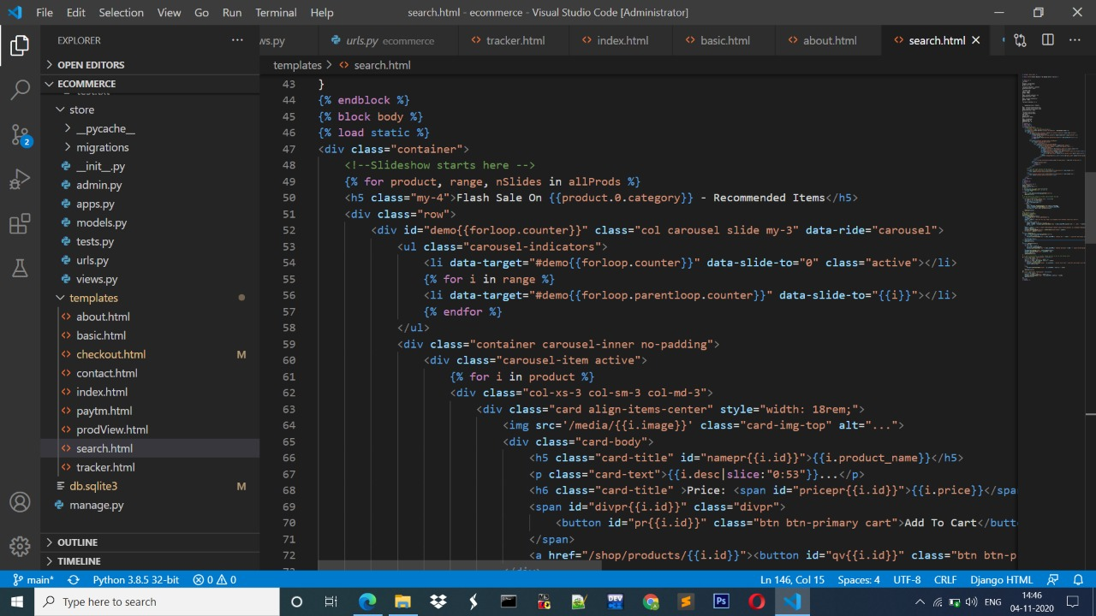
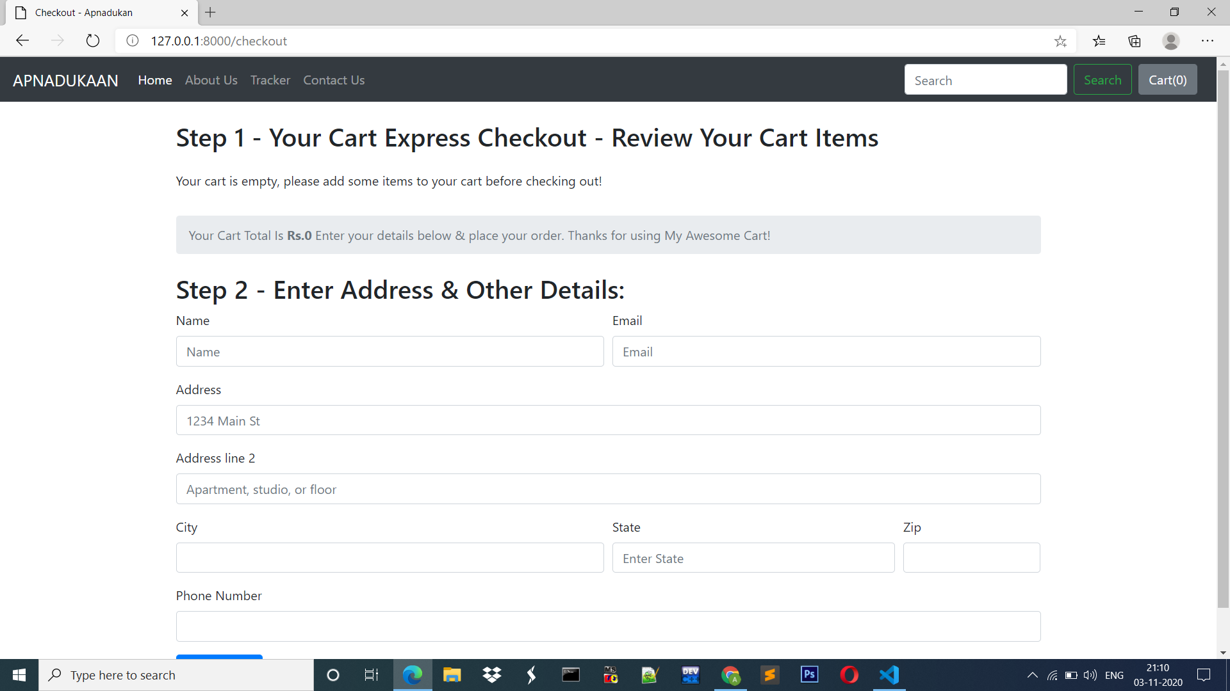
Screen Shots

Slide 9
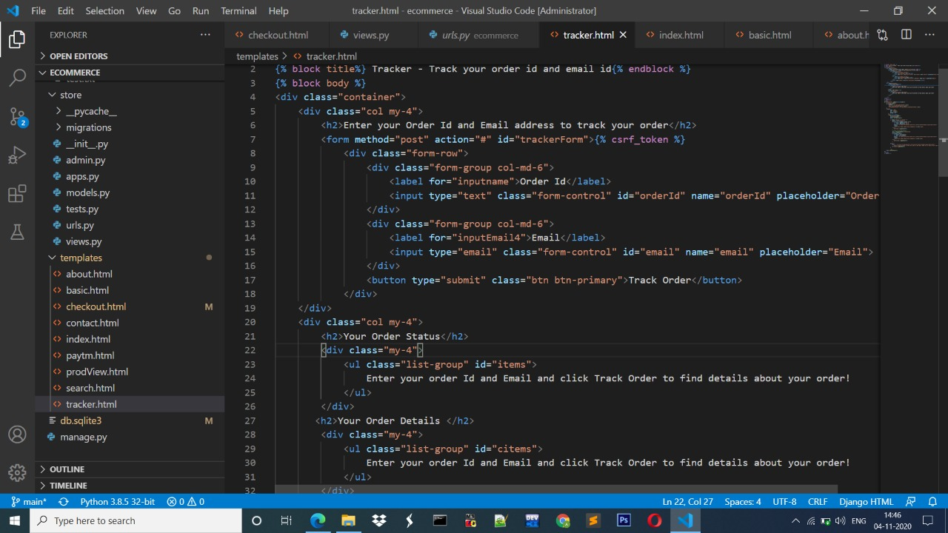
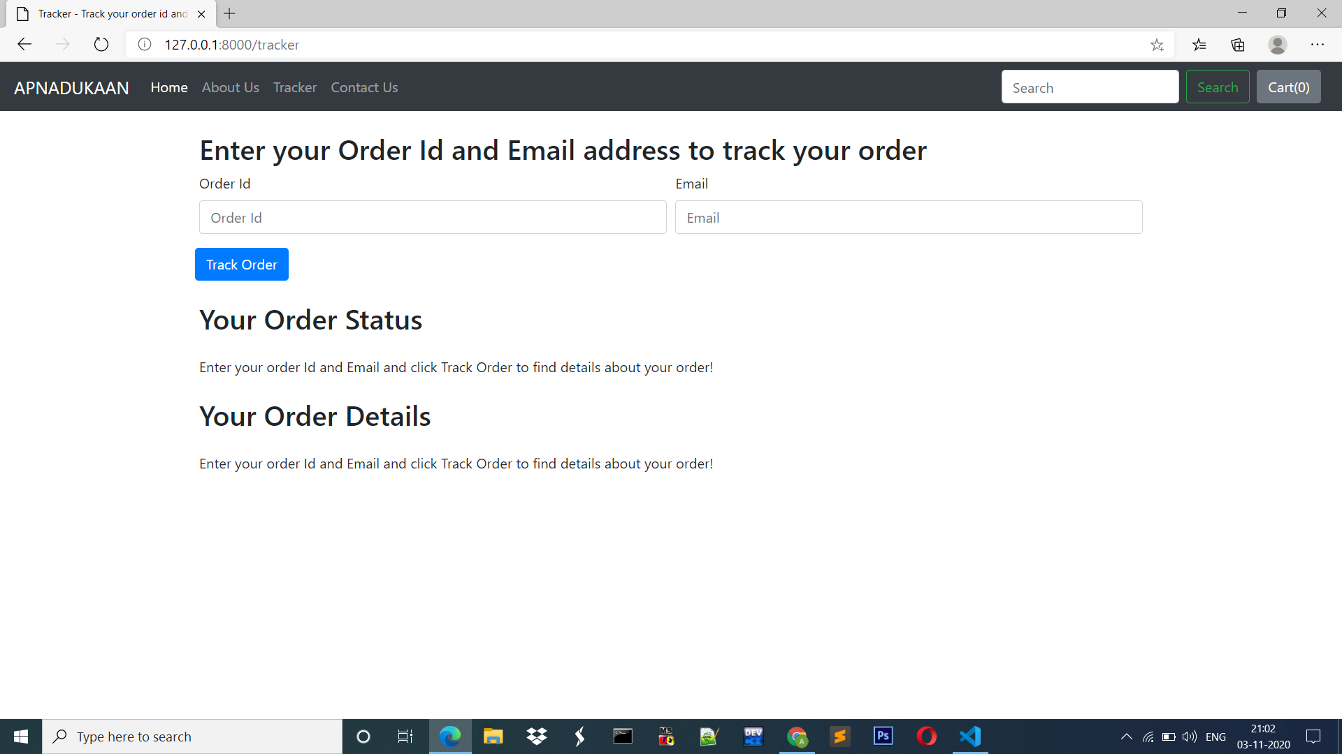
Screen Shots

Slide 10
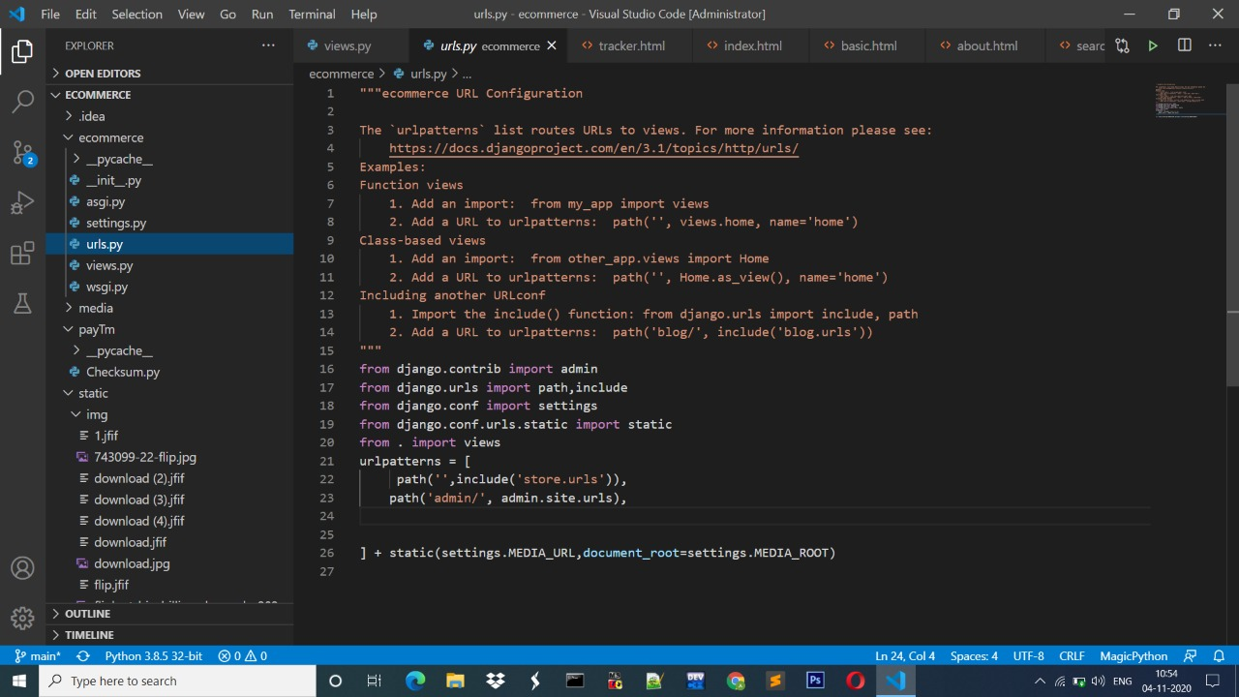
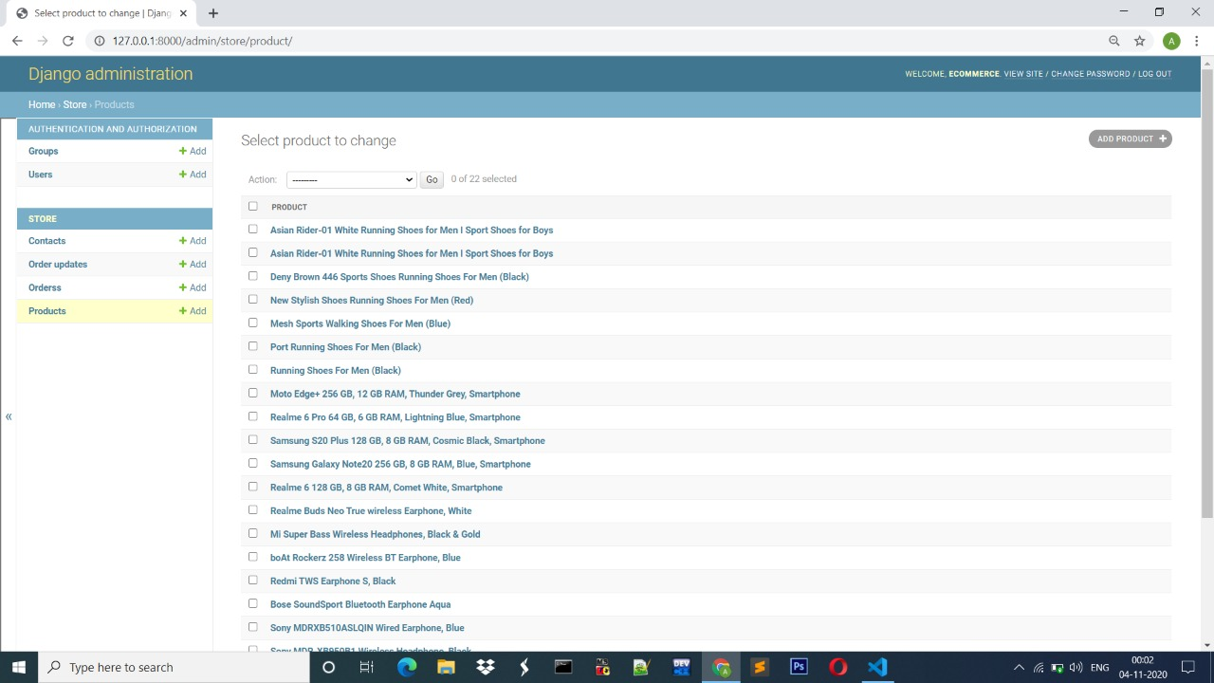
Screen Shots

Slide 11
Conclusion
Each and every time there are lot of website launch for getting the product and help you buy your favourite product from your own I try my level best to give all the facility to buy your product and get your product from your home .
DJANGO has a major role in this project.

Slide 12













Have a nice day

